Slide 1

moose for dcs world CARGO for Armoured personnel carriers

Slide 2
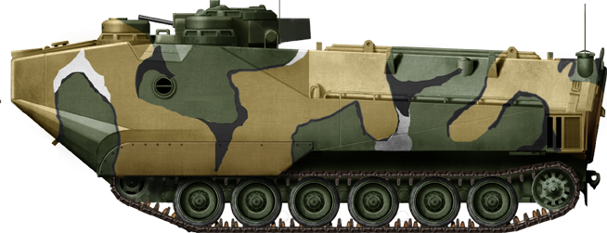
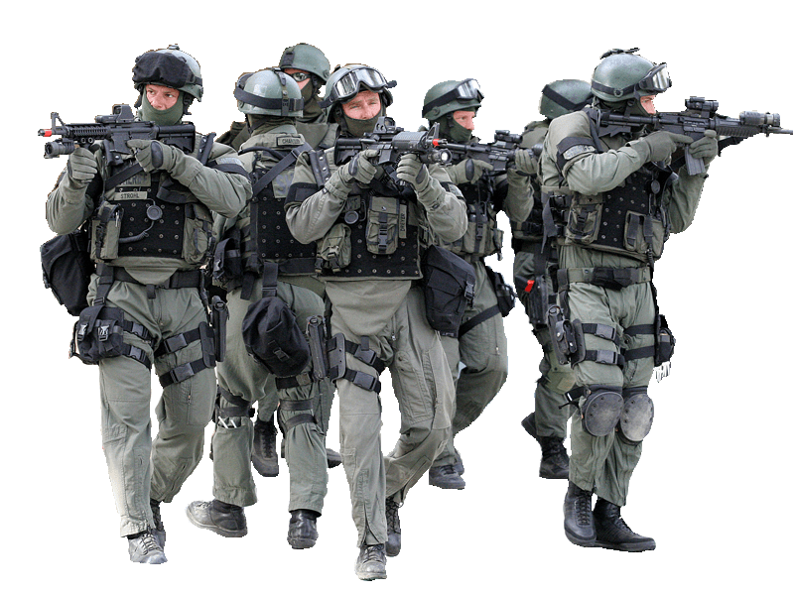
features
Pickup Coordinate
Board Cargo
route apc to pickup / deploy coordinates.
the apc follows the roads between pickup and deploy routes.
transports a cargo set.
combine different cargo types: infantry, mortars, manpads.
handles apc groups consisting of multiple apc units.
infantry unboards apc in case of enemy presence.
capture loaded / unloaded events and customize actions.
build chains of cargo handling actions.
easily build repeated cargo transportation workflows.
Road
Deploy Coordinate
Unboard Cargo

Slide 3
a small demonstration

Slide 4
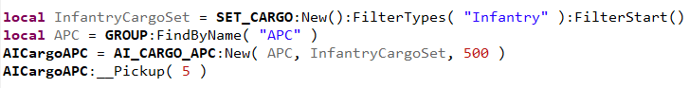
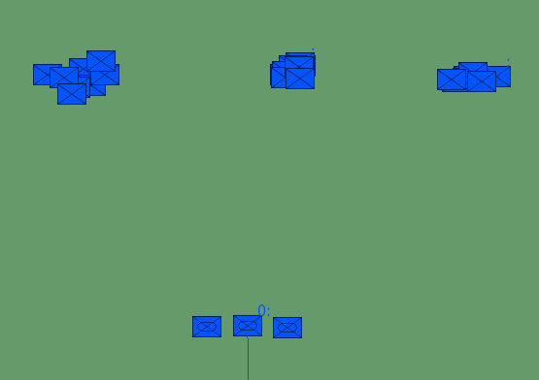
a simple cargo transport
1: Define a new SET_CARGO object InfantryCargoSet, and filter (or include) only the cargo registered of type “Infantry”.
2: Define the GROUP object APC.
3: Define the AI_CARGO_APC object AICargoAPC, using the new() method, providing:
The GROUP object APC.
The SET_CARGO object InfantryCargoSet.
A combat range in meters, which expresses the minimum distance when the infantry will unload the APC to battle enemies nearby!

Slide 5
declare and define cargo objects
CARGO_GROUP objects are logical objects that use a GROUP object as defined within the mission editor, and let that group be recognized and behave as cargo, so that it can be loaded and deployed by carriers.
There are two methods how you can declare these objects within your mission.

Slide 6



DECLARE and dEFINE cargo objects: in your mission script
Method #1: CARGO_GROUP objects are declared within the mission script.
Provide in the CARGO_GROUP:New() method which takes an existing GROUP object, and defines the type of the cargo, the name of the cargo, the boarding range and the near range.
The 1st parameter is a reference to an existing GROUP object in the mission.
The 2nd parameter defines the type of the cargo. This type given is very important. You can use the type name to filter cargo in a SET_CARGO object.
The 3rd parameter defines the name of the cargo. The cargo can be given a different name than the name of the GROUP object!
The 4th parameter is the range in meters, when the cargo will board / load towards the APC.
The 5th parameter is the range in meters when the cargo will be loaded into the APC when boarding and near to the APC.

Slide 7
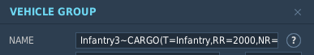

declare and define cargo objects: in the mission editor
Method #2: Groups in the Mission Editor that in the name the tag ~CARGO and are implicitly declared as CARGO_GROUP objects by MOOSE.
These groups are automatically detected by MOOSE at mission start, and for each of these groups, a CARGO_GROUP object is created in the background with the group name specified before the ~CARGO tag.
These CARGO_GROUP objects are then automatically included in SET_CARGO objects where the filter criteria is valid.
The filter criteria and other properties are specified by the parameters in brackets () as part of het group name, separated by commas:
T= expresses the type of the cargo. It is an alphameric name that is used as a reference to filter the SET_CARGO objects within your script!
RR= expresses the range in meters, when the cargo will board / load towards the APC.
NR= expresses the range in meters when the cargo will be loaded into the APC when boarding.

Slide 8
moose for dcs world CARGO for Armoured personnel carriers

Slide 9
declare and define cargo objects
CARGO_GROUP objects are logical objects that use a GROUP object as defined within the mission editor, and let that group be recognized and behave as cargo, so that it can be loaded and deployed by carriers.
There are two methods how you can declare these objects within your mission.

Slide 10
declare and define cargo objects: in the mission editor
Method #2: Groups in the Mission Editor that in the name the tag ~CARGO and are implicitly declared as CARGO_GROUP objects by MOOSE.
These groups are automatically detected by MOOSE at mission start, and for each of these groups, a CARGO_GROUP object is created in the background with the group name specified before the ~CARGO tag.
These CARGO_GROUP objects are then automatically included in SET_CARGO objects where the filter criteria is valid.
The filter criteria and other properties are specified by the parameters in brackets () as part of het group name, separated by commas:
T= expresses the type of the cargo. It is an alphameric name that is used as a reference to filter the SET_CARGO objects within your script!
RR= expresses the range in meters, when the cargo will board / load towards the APC.
NR= expresses the range in meters when the cargo will be loaded into the APC when boarding.

